Slide 1
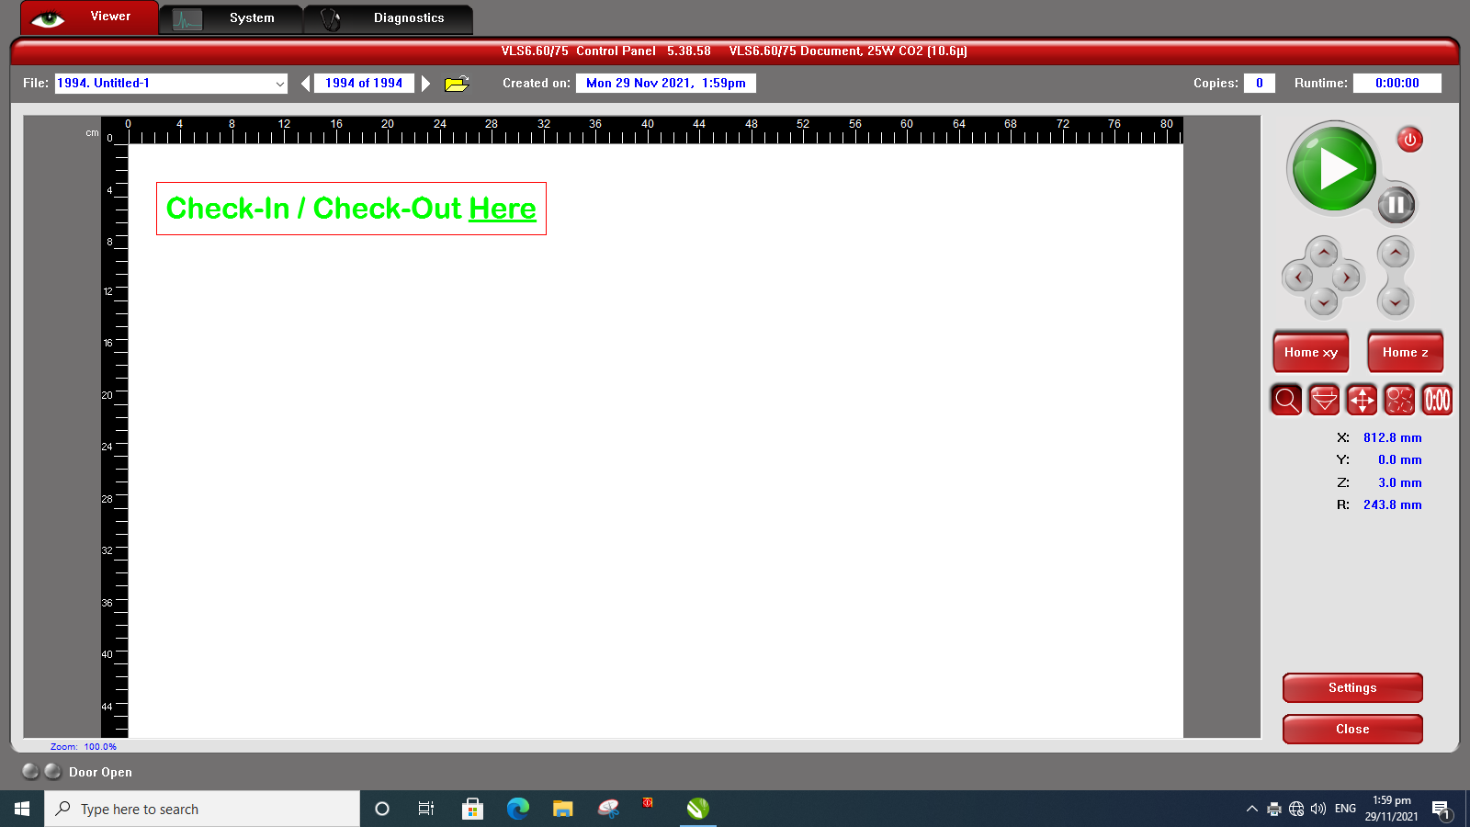
Laser Cutting Checklist
Before laser cutting, have you prepared-
Your cut file (dxf, dwg, svg or pdf) and/or image file
Transferred your file(s) to a thumb drive
Your cut material
Ensure that the following is turned on
Laser cutter
Air assist
HEPA filter
Checklist
Place material on plate, mark out the cutting area
Start CorelDraw, import file(s)
Convert lines for cutting to hairline
Adjust and reduce cutting area
Import the raster file and arrange
Send for print
Set laser cutting parameters (Power, Speed, Pulsing)
Move laser head to actual cut position on material(Click “Focus View” then click the machine bed.)
Move cut area to laser head position (Click “Move View” then click “To Pointer”.)
Check sizing (Air-cut)
Cut

